Slide 1






COMMERCE MENTORSHIP PROGRAM
FINAL REVIEW SESSION
COMM 295
Prepared by: Winson Yu

Slide 2





ABOUT ME

Slide 3
TABLE OF CONTENTS
Monopoly and Pricing With Market Power
Oligopoly
Game Theory
Uncertainty and Asymmetric Information

Slide 4
Monopoly and Pricing With Market Power

Slide 5

Monopoly and Pricing With Market Power
Monopoly: a sole supplier of a good for which there is no close substitute.
As a single supplier, a monopolist faces the entire (downward sloping) market demand.
A monopoly’s output is the market output
Profit Maximization: MR=MC
Profit-maximizing managers sets its quantity according to this formula:

Slide 6
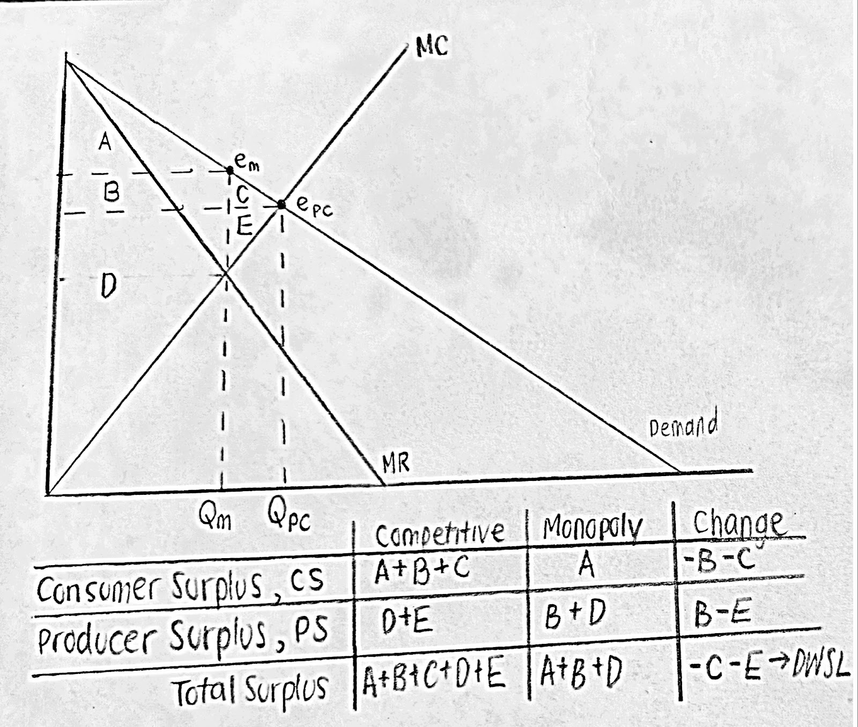
Comparison of Consumer and Producer Surplus

Slide 7
Pricing with Market Power
Perfect price discrimination: Monopolist charges the maximum price that each consumer is willing to pay.
Multi-group price discrimination: Splitting consumers into two or more groups based on their demand curve and charging different prices to each group.
Individual price discrimination: charging individual-specific prices to different consumers, which may or may not exactly equal consumers’ reservation prices (e.g. Suez Canal set tolls on ship-by-ship basis)
Non-linear price discrimination: Charging different prices based on the quantity (quantity discounts)
Two-Part Pricing: Charging an entry fee and a usage fee

Slide 8
Question 1
Consider a specialized bike store in Vancouver that negotiates with every single customer wanting to purchase a bike. The manager of the bike store is unsure of each customer’s maximum willingness to pay. Which of the following statements is true?
A. The bike store engages in perfect price discrimination.
B. The bike store engages in individual price discrimination.
C. The bike store is likely to use two-part pricing.
D. None of the above

Slide 9
Question 1
Consider a specialized bike store in Vancouver that negotiates with every single customer wanting to purchase a bike. The manager of the bike store is unsure of each customer’s maximum willingness to pay. Which of the following statements is true?
A. The bike store engages in perfect price discrimination.
B. The bike store engages in individual price discrimination.
C. The bike store is likely to use two-part pricing.
D. None of the above

Slide 10
Question 1
Consider a specialized bike store in Vancouver that negotiates with every single customer wanting to purchase a bike. The manager of the bike store is unsure of each customer’s maximum willingness to pay. Which of the following statements is true?
Individual price discrimination: charging individual-specific prices to different consumers, which may or may not exactly equal consumers’ reservation prices
Bike store uses the information of a buyer to try to determine and estimate each individual’s reservation price

Slide 11
Pricing with Market Power
Bundling: selling products together in sets
Pure bundling: selling just one bundle; no option to buy a bundle or separate items
works when there is a negative correlation between the demands of consumers.
Charging a lower price but increasing the number of consumers
Mixed bundling: allow the customer to buy the pure bundle or any of the bundle’s components separately
Peak Load Pricing: charging higher prices during periods of peak demand
used when there is a capacity constraint
increases profits and spreads demand during off-peak time

Slide 12
Question 2
A profit-maximizing monopoly firm sells hockey tape and pucks. Assume costs are zero. The willingness to pay for these two products by four customers is as follows:
A. Stand-alone pricing and pure bundling are equally profitable if X = $0.60.
B. Mixed bundling is more profitable than pure bundling if X = $0.50.
C. Profits from optimal pricing are the same for X = $0.30 and X = $0.40.
D. None of the above.
 | Hockey Tape | Pucks
Brock | $1.20 | X
Caleb | $1.10 | $0.90
Darron | $0.90 | $1.10
Ethan | x | $1.20

Slide 13
Question 2
A profit-maximizing monopoly firm sells hockey tape and pucks. Assume costs are zero. The willingness to pay for these two products by four customers is as follows:
A. Stand-alone pricing and pure bundling are equally profitable if X = $0.60.
B. Mixed bundling is more profitable than pure bundling if X = $0.50.
C. Profits from optimal pricing are the same for X = $0.30 and X = $0.40.
D. None of the above.
 | Hockey Tape | Pucks
Brock | $1.20 | X
Caleb | $1.10 | $0.90
Darron | $0.90 | $1.10
Ethan | x | $1.20

Slide 14
Question 2
A profit-maximizing monopoly firm sells hockey tape and pucks. Assume costs are zero. The willingness to pay for these two products by four customers is as follows:
C. Profits from optimal pricing are the same for X = $0.30 and X = $0.40.
Stand Alone Pricing when X = $0.60 → $0.90 x 3 + $0.90 x 3 = $5.40
Pure Bundling when X = $1.80 x 4 = $7.20
Mixed Bundling when X = $0.50 → $2 + $2 + $1.20 (hockey tape) + $1.20 (puck) = $6.40
Pure Bundling when X = $0.50 → $1.70 x 4 = $6.80
Pure Bundling Pricing when X = $0.30 → $1.50 x 4 = $6.00
Mixed Bundling Pricing when X = $0.30 → $2 + $2 + $1.20x2 = $6.40
Pure Bundling Pricing when X = $0.40 → $1.60 x 4 = $6.40
Mixed Bundling Pricing when X = $0.40 → $2 + $2 + $1.20x2 = $6.40
 | Hockey Tape | Pucks | Total WTP
Brock | $1.20 | X | $1.20 + x
Caleb | $1.10 | $0.90 | $2.00
Darron | $0.90 | $1.10 | $2.00
Ethan | x | $1.20 | $1.20 + x

Slide 15
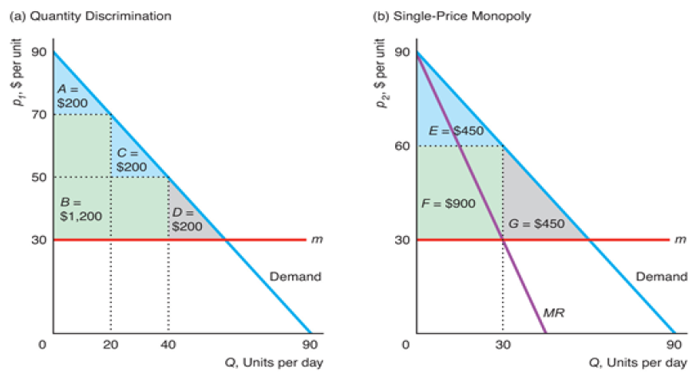
Question 3
Elizabeth’s demand curve is denoted by p = 90 – Q. The graph below:
(a) Shows the outcome of quantity-based price discrimination if the firm charges $70 each for the first 20 units and $50 each for additional units.
(b) Shows the outcome of profit-maximizing single price monopoly when the marginal cost is $30.
Which of the following statements is true:
A. The average price paid under situation (a) is the same as situation (b)
B. Revenue under situation (a) is double the revenue of situation (b)
C. Profits are higher in situation (b) than with situation (a)
D. None of the above

Slide 16
Question 3
Elizabeth’s demand curve is denoted by p = 90 – Q. The graph below:
(a) Shows the outcome of quantity-based price discrimination if the firm charges $70 each for the first 20 units and $50 each for additional units.
(b) Shows the outcome of profit-maximizing single price monopoly when the marginal cost is $30.
Which of the following statements is true:
A. The average price paid under situation (a) is the same as situation (b)
B. Revenue under situation (a) is double the revenue of situation (b)
C. Profits are higher in situation (b) than with situation (a)
D. None of the above

Slide 17
Question 3
Elizabeth’s demand curve is denoted by p = 90 – Q. The graph below:
(a) Shows the outcome of quantity-based price discrimination if the firm charges $70 each for the first 20 units and $50 each for additional units.
(b) Shows the outcome of profit-maximizing single price monopoly when the marginal cost is $30.
Average price paid in (a) is ($70 * 20 + $50 * 20)/40 = $60
Average price paid in (b) is $60

Slide 18
Question 4
A e-skateboard sharing company charges an annual membership fee of $20 and a fee per minute of $0.40. The marginal cost per minute (for maintenance, depreciation, etc.) is $0.10.
Consumers who buy one or more hours for any given trip get a discount on the per-minute price. This is best described as group price discrimination.
This pricing structure is an example of two-part pricing.
The pricing structure suggests consumers in this market are close to identical.
B and C.

Slide 19
Question 4
A e-skateboard sharing company charges an annual membership fee of $20 and a fee per minute of $0.40. The marginal cost per minute (for maintenance, depreciation, etc.) is $0.10.
Consumers who buy one or more hours for any given trip get a discount on the per-minute price. This is best described as group price discrimination.
This pricing structure is an example of two-part pricing.
The pricing structure suggests consumers in this market are close to identical.
B and C.
Access fee + per-unit fee
Can’t assume that the customers are identical; the pricing structure does not suggest anything about the similarity of consumers

Slide 20
Oligopoly

Slide 21
Oligopoly
Oligopolies are characterized by few sellers, limited entry, homogeneous or differentiated products, and firm’s awareness of strategic interdependence between each other.
Cartels: formed when oligopolistic firms collude in setting prices or quantities to raise their profits
Oligopolistic firms have incentives to form cartel (collude) to increase their profits.
Each member agrees to reduce its output from the level of output if it acted independently → market price rises and firms earn higher profits
Cartels tend to produce the output analogous to monopolies → helps achieve the highest possible collective profit
Producers in a cartel explicitly agree or collude to cooperate in setting prices and output to make more profits.
Cartels only work when all firms produce the same amount

Slide 22
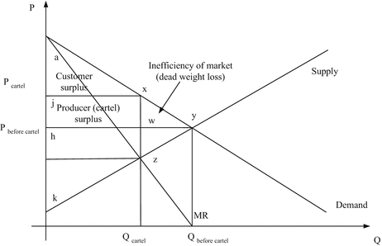
Collusion
If demand is sufficiently inelastic and cartel is enforceable, prices may be well above competitive levels.
Since price is higher than competitive price, cartels leads to DWL in the economy.
E.g. OPEC

Slide 23


Why Cartels Fail
Antitrust Laws (US) or Competitive Laws (Canada) prohibits the formation of cartels. The motivation behind such laws is to foster competition in the market and protect consumers
A cartel may fail if non-cartel members can readily undercut prices or can replace the supply reduction undertaken by cartels
It may also fail when members cheat. In a cartel, members have incentives to cheat as they can gain by cheating

Slide 24
Maintaining Cartels – Conditions for Success
1. Enforcement and Detection: Temptation to cheat may be deterred by threat of retaliation.
There must be a mechanism for detection of cheating and punishment for violators.
GE and Westinghouse included “most-favored-customer” clauses in their purchase agreements that ensured that the seller would not offer a lower price to any other current or future buyer without offering the same price decrease to the firms that signed these contracts → if company cheats by cutting prices, it has to lower prices to all previous buyers as well.
2. Potential for Monopoly Power: Cartels can be more successful when demand is more inelastic.
Government support or exemption from competition laws can help foster cartels.

Slide 25
Maintaining Cartels – Conditions for Success
3. Barriers to entry: limit the number of firms in a market
When new firms enter the market, the cartel is likely to fail.
The fewer the firms in a market, the more likely it is that other firms will know if a given firm cheats and the easier it is to impose penalties
4. Fringe firm consideration: Members of cartel must consider the actions of non-members (fringe firms) when making pricing decisions.

Slide 26
Different Types of Oligopolies
Cournot Duopoly: two firms compete in choosing quantities
Bertrand Duopoly: two firms compete in choosing prices
Best Response Functions: shows the firm’s best output as a function of the other firm’s output and depends on the firm’s marginal cost.
Nash-Cournot Equilibrium: the set of quantities chosen by firms where no firm can obtain higher profits by choosing a different quantity (holding the quantities of all other firms constant) → intersection of best-response curves

Slide 27
Solving Cournot Model and Deriving Best Response Functions
Step 1: Find the residual demand function
Step 2: Use the residual demand function to find the MR equation of each firm
Step 3: Set MR = MC for both firms
Step 4: Solve for Q_{A} and Q_{B}
Step 5: Use Q to find the price

Slide 28
Explanations of Steps:
Step 1: For Cournot oligopolies, where there are only two firms that are identical in marginal cost and their demand curves (this is also called a duopoly), we look for their residual demand curves so we can solve for the best-response functions.
Because the two firms compete with one another, they consider each other’s behavior when choosing profit-maximizing output.
The firms are concerned with the residual demand curve, which shows the market demand that is not met by other sellers at any given price.

Slide 29
Explanations of Steps:
Step 2: Once we know the residual demand function, we want to find the MR equation of each firm so we can set the profit maximizing condition that a firm should follow to maximize its profit given the behavior of the other firm
The firm’s best response - its profit maximizing output given the output of the other firm - is the output that equates its marginal revenue and its marginal cost
If the two firms have the same marginal cost and demand curves, then their best-response functions will be identical

Slide 30
Explanations of Steps:
Step 3: Set MR=MC and solve for the best response functions
Step 4: To solve for QA and QB, we take the best response functions of one firm and plug it into another. This will give us the quantity a firm should produce in response of another.

Slide 31
Question 5
There are two firms in a Cournot duopoly. The market demand function is Q = 339 – P and the cost function is C = 147Q. Find the equilibrium price, the quantity produced by each firm, and the profit of each firm.
For reference:
Step 1: Find the residual demand function
Step 2: Use the residual demand function to find the MR equation of each firm
Step 3: Set MR = MC for both firms
Step 4: Solve for QA and QB
Step 5: Use Q to find the price

Slide 32
Question 5
There are two firms in a Cournot duopoly. The market demand function is Q = 339 – P and the cost function is C = 147Q. Find the equilibrium price, the quantity produced by each firm, and the profit of each firm.
Step 1: Find the Residual Demand Curve
Market Demand: 339 – P = Q
Residual Demand: 339 – Q = P
339 – (Q_{A} + Q_{B}) = P
339 – Q_{A} – Q_{B} = P

Slide 33
Question 5
There are two firms in a Cournot duopoly. The market demand function is Q = 339 – P and the cost function is C = 147Q. Find the equilibrium price, the quantity produced by each firm, and the profit of each firm.
Step 2: Find Marginal Revenue Function
R_{A} = (339 – Q_{A} – Q_{B}) Q_{A}
R_{A} = 339Q_{A} – Q_{A}² – Q_{B}Q_{A}
MR_{A} = 339 – 2Q_{A} – Q_{B}

Slide 34
Question 5
There are two firms in a Cournot duopoly. The market demand function is Q = 339 – P and the cost function is C = 147Q. Find the equilibrium price, the quantity produced by each firm, and the profit of each firm.
Step 3: Set Marginal Revenue Equal to Marginal Cost
MC = 147
147 = 339 – 2Q_{A} – Q_{B}
192 = 2Q_{A} + Q_{B}
Q_{A} = 96 – 0.5Q_{B}
Q_{B} = 96 – 0.5Q_{A}

Slide 35
Question 5
There are two firms in a Cournot duopoly. The market demand function is Q = 339 – P and the cost function is C = 147Q. Find the equilibrium price, the quantity produced by each firm, and the profit of each firm.
Step 4: Solve for Q_{A} and Q_{B}
Q_{A} = 96 – 0.5(96 – 0.5Q_{A})
Q_{A} = 96 – 48 + 0.25Q_{A}
Q_{A} = 64
Q_{B} = 64
Q = 128

Slide 36
Question 5
There are two firms in a Cournot duopoly. The market demand function is Q = 339 – P and the cost function is C = 147Q. Find the equilibrium price, the quantity produced by each firm, and the profit of each firm.
Step 5: Find Price Using Q
P = 339 – 128
= $211

Slide 37


Question 6
American and United are duopolists, each with marginal cost equal to $147 per passenger and jointly facing market demand P = 339 – q_{A} – q_{B}. The Nash-Cournot equilibrium quantities and price were calculated as q_{A} = q_{B}= 64 and P* = $211. Suppose American and United successfully form a cartel and agree to share the market demand equally:
A. Each firm would reduce the quantity supplied by 25 percent
B. If American decided to cheat within the cartel, it would raise its price above that set by United
C. The deadweight loss per passenger in this market will decrease
D. The cartel arrangement can be described as a prisoners’ dilemma

Slide 38
Question 6
American and United are duopolists, each with marginal cost equal to $147 per passenger and jointly facing market demand P = 339 – q_{A} – q_{B}. The Nash-Cournot equilibrium quantities and price were calculated as q_{A} = q_{B}= 64 and P* = $211. Suppose American and United successfully form a cartel and agree to share the market demand equally:
A. Each firm would reduce the quantity supplied by 25 percent
B. If American decided to cheat within the cartel, it would raise its price above that set by United
C. The deadweight loss per passenger in this market will decrease
D. The cartel arrangement can be described as a prisoners’ dilemma

Slide 39
Question 6
American and United are duopolists, each with marginal cost equal to $147 per passenger and jointly facing market demand P = 339 – q_{A} – q_{B}. The Nash-Cournot equilibrium quantities and price were calculated as q_{A} = q_{B}= 64 and P* = $211. Suppose American and United successfully form a cartel and agree to share the market demand equally:
A. Each firm would reduce the quantity supplied by 25 percent
B. If American decided to cheat within the cartel, it would raise its price above that set by United
C. The deadweight loss per passenger in this market will decrease
D. The cartel arrangement can be described as a prisoners’ dilemma
MR = MC
339 - 2Q = 147
Q= 96, each firm produces 48
MC = 147
P= 339 - Q
R = 339Q-Q²
If American decided to cheat within the cartel, it would cut its price below that set by United
The deadweight loss per passenger in this market will increase
The cartel arrangement cannot be described as a prisoners’ dilemma.
No dominant strategy solution

Slide 40

Question 7
Assume that Intel and Nvidia are the only two firms that produce graphics cards that are used in high end computers. In this market, Intel and Nvidia’s products differ physically. From Intel’s long-standing advertising campaign, it has convinced some of the consumers in this market of its superiority. Therefore, consumers view Nvidia and Intel’s graphic cards as imperfect substitutes, which is reflected in their different estimated inverse demand functions:
p_{N} = 197-15.1_{qN}-0.3_{qI}
p_{I} = 490-10_{qI} - 6_{qN}
where price is dollars per graphics card, quantity is in millions of graphics cards, the subscript I indicates Intel, and the subscript N represents Nvidia. Assume that each firm faces a constant marginal cost of $40 per unit and has no fixed cost. The two firms compete by setting quantities simultaneously.
Derive each firm’s best response function. Solve for the Nash equilibrium quantities and prices.

Slide 41
Question 7
Assume that Intel and Nvidia are the only two firms that produce graphics cards that are used in high end computers. In this market, Intel and Nvidia’s products differ physically. From Intel’s long-standing advertising campaign, it has convinced some of the consumers in this market of its superiority. Therefore, consumers view Nvidia and Intel’s graphic cards as imperfect substitutes, which is reflected in their different estimated inverse demand functions:
p_{N} = 197-15.1_{qN}-0.3_{qI}
p_{I} = 490-10_{qI} - 6_{qN}
where price is dollars per graphics card, quantity is in millions of graphics cards, the subscript I indicates Intel, and the subscript N represents Nvidia. Assume that each firm faces a constant marginal cost of $40 per unit and has no fixed cost. The two firms compete by setting quantities simultaneously.
Derive each firm’s best response function. Solve for the Nash equilibrium quantities and prices.
Different demand equations, imperfect substitutes → therefore, we will work with profit to find the best response functions
Profit in this case is π = (P-MC)Q
Find best response functions by taking the derivative of the profit functions and setting them equal to 0.
dπ_{N}/dq_{N} = 157 - 30.2q_{N} - 0.3q_{I} = 0
q_{N} = (157 - 0.3 q_{I}) /30.2 → best response function for Nvidia
dπ_{I} / dq_{i} = 450 - 20q_{I} - 6q_{N} = 0
q_{I} = (450-6q_{N} )/20 → best response function for Intel
The firms’ profit functions are
π_{N} = (197 - 15.1q_{N} - 0.3q_{I} - 40) q_{N}
π_{I} = (490 - 10q_{I} - 6q_{N} - 40) q_{I}
Simplified profit functions:
π_{N} = 157q_{N} - 15.1q_{N}² - 0.3q_{I}q_{N}
π_{I} = 450q_{I} - 10q_{I}² - 6q_{N}q_{I}

Slide 42
Question 7
Assume that Intel and Nvidia are the only two firms that produce graphics cards that are used in high end computers. In this market, Intel and Nvidia’s products differ physically. From Intel’s long-standing advertising campaign, it has convinced some of the consumers in this market of its superiority. Therefore, consumers view Nvidia and Intel’s graphic cards as imperfect substitutes, which is reflected in their different estimated inverse demand functions:
p_{N} = 197-15.1_{qN}-0.3_{qI}
p_{I} = 490-10_{qI} - 6_{qN}
where price is dollars per graphics card, quantity is in millions of graphics cards, the subscript I indicates Intel, and the subscript N represents Nvidia. Assume that each firm faces a constant marginal cost of $40 per unit and has no fixed cost. The two firms compete by setting quantities simultaneously.
Derive each firm’s best response function. Solve for the Nash equilibrium quantities and prices.
Find best response functions by taking the derivative of the profit functions and setting them equal to 0.
dπ_{N} / dq_{N} = 157 - 30.2q_{N} - 0.3q_{I} = 0
q_{N} = (157 - 0.3 q_{I}) /30.2 → best response function for Nvidia
dπ_{I} / dq_{i} = 450 - 20q_{I} - 6q_{N} = 0
q_{I} = (450-6q_{N} )/20 → best response function for Intel
Substitute best response function into each other:
q_{N} = 15,025/3011 = 4.99
q_{I} = 63240/3011= 21.00
Find price by substituting these quantities back into the original estimated inverse demand functions
P_{A} = $115.2
P_{I} = 250.
Simplified profit functions:
π_{N} = 157q_{N} - 15.1q_{N}² - 0.3q_{I}q_{N}
π_{I} = 450q_{I} - 10q_{I}² - 6q_{N}q_{I}

Slide 43
Game Theory Pt. 1

Slide 44
Game Theory
Game Theory: tries to determine the optimal strategy for each player
A game consists of:
Players (i.e. firms)
Rules (simultaneous, sequential)
Strategies (price and quantity decisions, given the other’s move)
Payoffs (what each player receives for the combination of strategies)
Static Game: each player acts once and at the same time
Dynamic Game: arises when players move sequentially or repeatedly
Dominant Strategy: the strategy that is best no matter what one’s rival does Nash Equilibrium: the set of strategies such that each player is doing the best it can, GIVEN the strategy of the rival player(s)

Slide 45
Game Theory
Prisoner’s Dilemma Game:
1. There is a dominant strategy solution
2. An alternative outcome exists that provides higher payoffs for all players
In a prisoner’s dilemma game, the Nash Equilibrium can be worse than a
possible outcome in the game
There can be another possible outcome that can give better payoffs than the Nash Equilibrium, but is not achieved
Player A | Player B
 |  | Confess | Don’t Confess
 | Confess | -2, -2 | 0, -3
 | Don’t Confess | -3, 0 | -1, -1

Slide 46
Game Theory
Cooperative Game: Players negotiate binding contracts that allow them to plan join strategies.
e.g. Buyer and seller negotiating the price of a good/service or a joint venture by two firms.
Non-Cooperative Game: Negotiation or enforcement of binding contracts between players is not possible.

Slide 47
Question 8
The following diagram below shows the payoff matrix for the decisions of two stove manufacturers, Northwest Stoves and Regency Appliances.
Northwest Stoves | Regency Appliances
 |  | Make an Acquisition | Merge with a Competitor | Release New Product
 | Make an Acquisition | 0, 0 | 8, 3 | 18, 6
 | Merge with a Competitor | 3, 8 | 18, 18 | 23, 12
 | Cut Unprofitable Product from Lineup | 6, 18 | 12, 23 | 21, 21
A. Is there a Nash Equilibrium?
B. Is this a Prisoner’s Dilemma Game?

Slide 48
Question 8
The following diagram below shows the payoff matrix for the decisions of two stove manufacturers, Northwest Stoves and Regency Appliances.
Northwest Stoves | Regency Appliances
 |  | Make an Acquisition | Merge with a Competitor | Release New Product
 | Make an Acquisition | 0, 0 | 8, 3 | 18, 6
 | Merge with a Competitor | 3, 8 | 18, 18 | 23, 12
 | Cut Unprofitable Product from Lineup | 6, 18 | 12, 23 | 21, 21
A. Is there a Nash Equilibrium?
the set of strategies such that each player is doing the best it can, GIVEN the strategy of the rival player(s)

Slide 49
Question 8
The following diagram below shows the payoff matrix for the decisions of two stove manufacturers, Northwest Stoves and Regency Appliances.
Northwest Stoves | Regency Appliances
 |  | Make an Acquisition | Merge with a Competitor | Release New Product
 | Make an Acquisition | 0, 0 | 8, 3 | 18, 6
 | Merge with a Competitor | 3, 8 | 18, 18 | 23, 12
 | Cut Unprofitable Product from Lineup | 6, 18 | 12, 23 | 21, 21
B. Is this a Prisoner’s Dilemma Game?
No, there is no dominant strategy solution

Slide 50
Game Theory
Maximin Strategy: risk averse strategy that maximizes the minimum possible payoff
“What is the minimum payoff I can get if I use this strategy?”
The player then chooses the strategy with the highest minimum payoff
A maximin solution occurs when both players play the maximin strategy
Tit-for-Tat Strategy: repeated game strategy in which a player responds in kind to an opponent’s previous move, cooperating with cooperative rivals and retaliating against uncooperative ones.

Slide 51
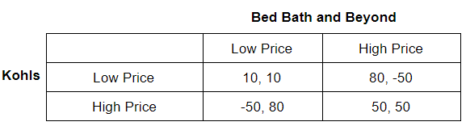
Tit-for-Tat Strategy
If both Kohls and BBBY play a “tit for tat” strategy, they start by cooperating (high price) and then do what the rival did before.
If Kohls “defects” and chooses a low price, Kohl gains +30 (=80-50) in the first period. But then it loses 40 (=50-10) in the subsequent period if it plays low
It will lose 100 ((50-(-50)) if it plays high. Therefore, it would not want to defect.

Slide 52
Question 9
Apple | Samsung
 |  | Do Not Invest | Invest
 | Do Not Invest | 0, 0 | 0, -25
 | Invest | 5, 0 | 20, 20
The maximin solution is also a Nash equilibrium in this case.
The maximin solutions provides a payoff of 20 to Samsung.
The maximin solution provides a payoff of 5 to Apple.
Neither firm has a dominant strategy in this game
None of the above

Slide 53
Question 9
Apple | Samsung
 |  | Do Not Invest | Invest
 | Do Not Invest | 0, 0 | 0, -25
 | Invest | 5, 0 | 20, 20
The maximin solution is also a Nash equilibrium in this case.
The maximin solutions provides a payoff of 20 to Samsung.
The maximin solution provides a payoff of 5 to Apple.
Neither firm has a dominant strategy in this game
None of the above
Nash Equilibrium: Samsung/Apple should both invest
Maximin for Apple: lowest possible payout (do not invest, invest) → (0 , 5)

Slide 54
Stackelberg Oligopoly
Stackelberg Oligopoly: A sequential game in an oligopoly where there is one leader and one follower (could have several followers).
The leader sets its output first, and then the followers will make its best response to the leader’s output decision
If a leader can predict what the follower will do before the follower acts, then the leader can choose their output level to manipulate their followers and benefit at the follower’s expense
Can be illustrated with a game tree
First mover has an advantage
Mercedes-Benz | Audi
 |  | Cut Cars From Lineup | Introduce Lease/Finance Incentive | Release New Model
 | Cut Cars From Lineup | 0, 0 | 31, 20 | 46, 23
 | Introduce Lease/Finance Incentive | 20, 31 | 41, 41 | 51, 38
 | Release New Model | 23, 46 | 38, 51 | 46, 46

Slide 55
Stackelberg Oligopoly
Cut Cars from Lineup → CC
Lease/Finance Incentive → LF
Release New Model → NM
Profits
CC
(46, 46)
CC
Audi
LF
(38, 51)
NM
(23, 46)
CC
(51, 38)
Mercedes- Benz
(Leader)
LF
Audi
LF
(41, 41)
NM
(20, 31)
CC
(46, 23)
NM
Audi
LF
(31, 20)
NM
(0, 0)
Leader’s Decision
Follower’s Decision
(Mercedes, Audi)

Slide 56
Stackelberg Oligopoly
Cut Cars from Lineup → CC
Lease/Finance Incentive → LF
Release New Model → NM
Profits
CC
(46, 46)
Mercedes-Benz | Audi
 |  | Cut Cars From Lineup | Introduce Lease/Finance Incentive | Release New Model
 | Cut Cars From Lineup | 0, 0 | 31, 20 | 46, 23
 | Introduce Lease/Finance Incentive | 20, 31 | 41, 41 | 51, 38
 | Release New Model | 23, 46 | 38, 51 | 46, 46
CC
Audi
LF
(38, 51)
NM
(23, 46)
CC
(51, 38)
Mercedes- Benz
(Leader)
LF
Audi
LF
(41, 41)
NM
(20, 31)
CC
(46, 23)
NM
Audi
LF
(31, 20)
NM
(0, 0)
Leader’s Decision
Follower’s Decision

Slide 57
Stackelberg Oligopoly
Cut Cars from Lineup → CC
Lease/Finance Incentive → LF
Release New Model → NM
Profits
CC
(46, 46)
The strategy for Audi is a contingent strategy:
1) Choose Lease/Finance Incentive if Mercedes chooses to Release New Model
2) Choose Lease/Finance Incentive if Mercedes chooses Lease/Finance Incentive
3) Release New Model if Mercedes chooses to Cut Cars From Lineup
CC
Audi
LF
(38, 51)
NM
(23, 46)
CC
(51, 38)
Mercedes- Benz
(Leader)
LF
Audi
LF
(41, 41)
NM
(20, 31)
CC
(46, 23)
NM
Audi
LF
(31, 20)
NM
(0, 0)
Leader’s Decision
Follower’s Decision

Slide 58
Question 11
Cut Cars from Lineup → CC
Lease/Finance Incentive → LF
Release New Model → NM
Use the game tree to choose the best answer:
If Mercedes chooses New Model instead of Reduce Lineup, Audi’s best response strategy changes.
If Mercedes chooses New Model instead of Reduce Lineup, Audi’s best action or move changes.
The question of who goes first makes no difference to each firm’s payoff.
None of the above.
Profits
CC
(46, 46)
CC
Audi
LF
(38, 51)
NM
(23, 46)
CC
(51, 38)
Mercedes- Benz
(Leader)
LF
Audi
LF
(41, 41)
NM
(20, 31)
CC
(46, 23)
NM
Audi
LF
(31, 20)
NM
(0, 0)
Leader’s Decision
Follower’s Decision

Slide 59
Question 11
Cut Cars from Lineup → CC
Lease/Finance Incentive → LF
Release New Model → NM
Use the game tree to choose the best answer:
If Mercedes chooses New Model instead of Reduce Lineup, Audi’s best response strategy changes.
If Mercedes chooses New Model instead of Reduce Lineup, Audi’s best action or move changes.
The question of who goes first makes no difference to each firm’s payoff.
None of the above.
Strategy doesn’t change, but Audi’s best action or move changes
Profits
CC
(46, 46)
CC
Audi
LF
(38, 51)
NM
(23, 46)
CC
(51, 38)
Mercedes- Benz
(Leader)
LF
Audi
LF
(41, 41)
NM
(20, 31)
CC
(46, 23)
NM
Audi
LF
(31, 20)
NM
(0, 0)
Leader’s Decision
Follower’s Decision

Slide 60

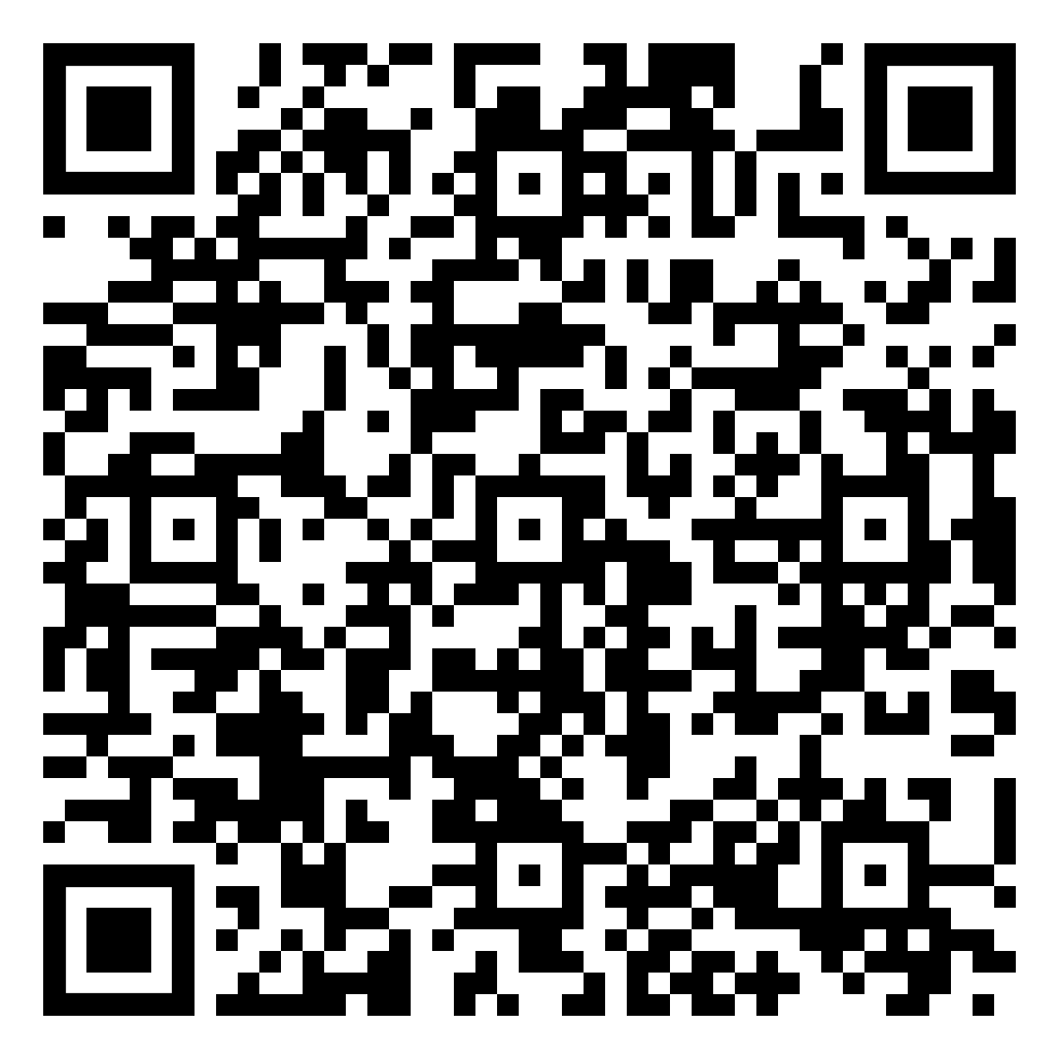

Slide 61
Game Theory Pt. 2

Slide 62
Game Theory
Referring to our Stackelberg oligopoly example, there are subgames within it
Subgame: consists of all the subsequent actions that players can take (given the actions already taken) and the corresponding payoffs
Subgame-perfect Nash equilibrium: can be found through backwards induction; occurs when the players’ strategies form a Nash equilibrium in every subgame (including the overall game)
the set of strategies such that each player is doing the best it can, GIVEN the strategy of the rival player(s)

Slide 63
Game Theory
Credible Threat: for a threat to be credible, the rival must believe that it is in the player’s best interest to use it
In simultaneous games, firms will produce the nash equilibrium quantity
Threats will not be credible if output hasn’t been produced yet
Commitment: changes a non-credible threat into a credible threat
Entry Deterrence: in some markets, an established firm (also known as incumbent) firm might be able to act strategically to prevent rivals from entering the market by moving first

Slide 64
Game Theory
Four Methods of Deterring Entrance:
Paying to prevent entry using exclusion contracts: incumbent firm will pay to prevent entrance
Limit pricing: setting low enough price (or high enough output) so that another firm cannot enter profitably
Only credible if incumbent has some advantage over its rival (lower costs) Incumbent would not lower price if it makes them unprofitable

Slide 65
Game Theory
3. Reputation effects in repeated games: if a game is played only once, players are rational, and payoffs and rationality are common knowledge, then entry cannot be deterred
If the game is repeated and if the incumbent’s payoffs are not known by the potential entrant, then entry may be deterred
In a repeated game, even if it is not profitable for a firm to fight, it may be a good strategy if its profits are not common knowledge and the potential rivals have incomplete information
Incumbent develops a reputation for being a tough competitor
4. Investments to lower marginal cost: incumbent makes costly investment that lowest marginal cost
Incumbent becomes more difficult firm to compete against if entry occurs
Used to deter entry

Slide 66
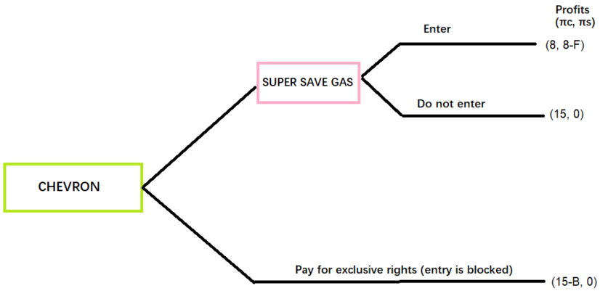
Question 12:
F → fixed cost of Super Save Gas
B → payment to the provincial government to prevent entry (exclusivity fee)
What range of values (for F and B) would effectively block entry?
What range of values (for F) would Super Save Gas to enter?

Slide 67
Question 12:
F → fixed cost of Super Save Gas
B → payment to the provincial government to prevent entry (exclusivity fee)
What range of values (for F and B) would effectively block entry?
Entry is blocked when F>8 and when B<=7
What range of values (for F) would Super Save Gas to enter?
F<=8

Slide 68
Question 13
In British Columbia, Visions and The Source compete in the market for electronics. The matrix below shows profits for the firms for quantities set according to a Cournot duopoly and a Cartel agreement. (In each cell, the payoff to Visions is on the left)
The game is a prisoner’s dilemma when ? takes the following range of values:
If X= 650, the Nash Equilibrium payoffs are:
Visons | The Source
 |  | Cartel Quantity | Cournot Quantity
 | Cartel Quantity | ?, ? | 500, 750
 | Cournot Quantity | 750, 500 | 600, 600

Slide 69
Question 13
In British Columbia, Visions and The Source compete in the market for electronics. The matrix below shows profits for the firms for quantities set according to a Cournot duopoly and a Cartel agreement. (In each cell, the payoff to Visions is on the left)
The game is a prisoner’s dilemma when ? takes the following range of values:
Prisoner’s Dilemma Game: 1) There is a dominant strategy solution 2) An alternative outcome exists that provides higher payoffs for all players
In a prisoner’s dilemma game, the Nash Equilibrium can be worse than a possible outcome in the game
There can be another possible outcome that can give better payoffs than the Nash Equilibrium, but is not achieved
600 < ? < 750
Visons | The Source
 |  | Cartel Quantity | Cournot Quantity
 | Cartel Quantity | ?, ? | 500, 750
 | Cournot Quantity | 750, 500 | 600, 600

Slide 70
Question 13
In British Columbia, Visions and The Source compete in the market for electronics. The matrix below shows profits for the firms for quantities set according to a Cournot duopoly and a Cartel agreement. (In each cell, the payoff to Visions is on the left)
If X= 650, the Nash Equilibrium payoffs are:
600, 600
Visons | The Source
 |  | Cartel Quantity | Cournot Quantity
 | Cartel Quantity | ?, ? | 500, 750
 | Cournot Quantity | 750, 500 | 600, 600

Slide 71
Question 14
Consider the following game with a police officer and Mitchell in an alternate universe.
Find all values of x and y such that the game has a dominant strategy solution.
Find all values of x and y such that (Speed Trap, Drive Slow) is a Nash equilibrium.
Find all values of x and y such that (Grab Donuts, Drive Slow) is a Nash equilibrium.
Find all values of x and y such that (Grab Donuts, Drive Fast) is a Nash equilibrium
Police Offer | Mitchell
 |  | Drive Slow | Drive Fast
 | Set Up Speed Trap | 0, 0 | 3, -1
 | Go Home and Grab Donuts | 1, 2 | x, y

Slide 72
Question 14
Consider the following game with a police officer and Mitchell in an alternate universe.
1. Find all values of x and y such that the game has a dominant strategy solution.
Only Grab Donuts can be the dominant strategy for the Police Officer and Drive Slow for Mitchell. Hence, x > 3 and y < 2.
Police Offer | Mitchell
 |  | Drive Slow | Drive Fast
 | Set Up Speed Trap | 0, 0 | 3, -1
 | Go Home and Grab Donuts | 1, 2 | x, y

Slide 73
Question 14
Consider the following game with a police officer and Mitchell in an alternate universe.
2. Find all values of x and y such that (Speed Trap, Drive Slow) is a Nash equilibrium.
No values of x and y can make this possible, because when Mitchell drives slow, set up a speed trap is not a best response for the Police Officer (his best response is to go home and grab donuts)
Police Offer | Mitchell
 |  | Drive Slow | Drive Fast
 | Set Up Speed Trap | 0, 0 | 3, -1
 | Go Home and Grab Donuts | 1, 2 | x, y

Slide 74
Question 14
Consider the following game with a police officer and Mitchell in an alternate universe.
3. Find all values of x and y such that (Grab Donuts, Drive Slow) is a Nash equilibrium.
As long as y< 2 and x E R, (Grab Donuts, Drive Slow) is a NE.
Police offer’s drive fast payoffs (x) do not matter, as the decision we are looking at is the drive slow case
Police Offer | Mitchell
 |  | Drive Slow | Drive Fast
 | Set Up Speed Trap | 0, 0 | 3, -1
 | Go Home and Grab Donuts | 1, 2 | x, y

Slide 75
Question 14
Consider the following game with a police officer and Mitchell in an alternate universe.
4. Find all values of x and y such that (Grab Donuts, Drive Fast) is a Nash equilibrium
As long as x >3 and y>2, (Grab Donuts, Drive Fast) is a NE.
Police Offer | Mitchell
 |  | Drive Slow | Drive Fast
 | Set Up Speed Trap | 0, 0 | 3, -1
 | Go Home and Grab Donuts | 1, 2 | x, y

Slide 76
Question 15
Suppose now that Visions is initially the only firm in this market and earns a profit of 2800 if it remains a monopolist. However, The Source can enter the market with the following two conditions: (i) The Source pays an up-front fixed investment cost of C; and (ii) Visions chooses to not obtain a patent prior to The Source’s entry decision. If entry occurs, Visions and The Source will produce the Cournot quantity. The cost to Visions of obtaining a patent is P. If The Source does not enter, its payoff is zero.
1. Draw the extensive form for this sequential game.
2. a) For what range of values for C and P will The Source enter the market?
2. b) Explain briefly:

Slide 77
Question 15
Suppose now that Visions is initially the only firm in this market and earns a profit of 2800 if it remains a monopolist. However, The Source can enter the market with the following two conditions: (i) The Source pays an up-front fixed investment cost of C; and (ii) Visions chooses to not obtain a patent prior to The Source’s entry decision. If entry occurs, Visions and The Source will produce the Cournot quantity. The cost to Visions of obtaining a patent is P. If The Source does not enter, its payoff is zero.
1. Draw the extensive form for this sequential game.
Enter
(600, 600-c)
The Source
Visions
Do Not Enter
(2800, 0)
(2800-P, 0)
(Vision’s payoff, The Source’s payoff)

Slide 78
Question 15
Enter
(600, 600-c)
The Source
Visions
Do Not Enter
(2800, 0)
(2800-P, 0)
(Vision’s payoff, The Source’s payoff)
2. a) For what range of values for C and P will The Source enter the market?
C=<600 and P>2200
2. b) Explain briefly: If C>600, entry is not profitable for The Source, therefore, The Source would not enter.
When P=<2200, Visions could obtain a patent to deter entry and receive a payoff higher than or equal to 600 if it did not obtain a patent.

Slide 79
Question 16
Suppose that you own a convenience store called Corner 21 in Kelowna. Another entrepreneur in the same area is thinking about opening a convenience store as well. You threaten the potential entrant with a price war if it enters. Assume that the entrepreneur knows your payoffs.
1. Is your threat credible? Explain.
2. How much are you willing to pay the potential entrant to keep it out of the market? (The maximum amount you are willing to pay) Explain.
3. Will the potential entrant accept your offer? Explain.
Accommodate
(2, 7)
You
Enter
Entrant
Price War
(-1, 6)
Stay Out
(0, 48)
(Entrant, You)

Slide 80
Question 16
Suppose that you own a convenience store called Corner 21 in Kelowna. Another entrepreneur in the same area is thinking about opening a convenience store as well. You threaten the potential entrant with a price war if it enters. Assume that the entrepreneur knows your payoffs.
1. Is your threat credible? Explain.
Your threat is NOT credible - it is not credible because if entry occurs, you get 7 by accommodating and only 6 in price war. You get more by accommodating. You therefore have an incentive to accommodate and do not have an incentive to start a price war.
Accommodate
(2, 7)
You
Enter
Entrant
Price War
(-1, 6)
Stay Out
(0, 48)
(Entrant, You)

Slide 81
Question 16
Suppose that you own a convenience store called Corner 21 in Kelowna. Another entrepreneur in the same area is thinking about opening a convenience store as well. You threaten the potential entrant with a price war if it enters. Assume that the entrepreneur knows your payoffs.
2. How much are you willing to pay the potential entrant to keep it out of the market? (The maximum amount you are willing to pay) Explain. Your threat is NOT credible.You would be willing to offer up to a maximum of 41 to keep the entrant out of the market. The reason is that you get 48 if the entrant stays out and only 7 if it enters. As 48 – 7 = 41, you would gain as long as the payment is less than or equal to 41.
Accommodate
(2, 7)
You
Enter
Entrant
Price War
(-1, 6)
Stay Out
(0, 48)
(Entrant, You)

Slide 82
Question 16
Suppose that you own a convenience store called Corner 21 in Kelowna. Another entrepreneur in the same area is thinking about opening a convenience store as well. You threaten the potential entrant with a price war if it enters. Assume that the entrepreneur knows your payoffs.
3. Will the potential entrant accept your offer?
The potential entrant will accept your offer as long as it exceeds 2 because the entrant gets 2 if it enters and would be willing to stay out as long as it gets more than 2 for staying out.
Accommodate
(2, 7)
You
Enter
Entrant
Price War
(-1, 6)
Stay Out
(0, 48)

Slide 83
Uncertainty

Slide 84
Uncertainty
To measure risk, we must know:
1. All the possible outcomes.
2. The probability that each outcome will occur.
Two measures to help describe and compare risky choices are:
1. Expected value E(X)
The weighted average of the values resulting from all possible outcomes.
Assume n possible outcomes Values of possible outcomes: X₁, X₂, ..., X_{n}.
Probability of each outcome: P₁, P₂, ..., P_{n}.
E(X) = P₁X₁ + P₂X₂ + ... + P_{n}X_{n}

Slide 85
Uncertainty
2. Variability
Variability comes from deviations in actual payoffs relative to the expected payoff.
Greater variability of actual payoffs the expected value signals greater risk.
Variance or Standard Deviation measures variability.
Variance: σ² = P₁(X₁-E(X))² + P₂(X₂-E(X))² + ... + P_{n}(X_{n}-E(X))²
Standard Deviation: Take the square root of variance

Slide 86
Attitude Towards Risk
Risk Averse: unwilling to take a fair bet
Utility function is concave to the wealth axis; utility rises with wealth, but at a diminishing rate
diminishing marginal utility of wealth: extra pleasure from each extra dollar of wealth is smaller than the extra pleasure from the previous dollar
e.g. if a stock (high risk) and a GOC bond (zero risk) has the same return/expected value, a risk averse person would choose the bond
If you dislike risk, then you may choose a riskier investment only if it gives you sufficiently higher expected value than the less risky alternative
choose the option that gives the highest expected utility.

Slide 87
Attitude Towards Risk
Risk Premium: maximum amount that a decision maker would pay to avoid taking a risk
The minimum extra compensation (premium) that a decision maker would require to willingly incur a risk

Slide 88
Attitude Towards Risk
Risk Premium: maximum amount that a decision maker would pay to avoid taking a risk
The minimum extra compensation (premium) that a decision maker would require to willingly incur a risk

Slide 89
Question 17
If Allyson invests the money she has in her savings account in a GOC bond, her future wealth is equal to $100,000 and she faces zero risk (hypothetically no inflation, currency devaluation, and default risk). If she instead invests in Tesla stock (more volatile and riskier investment), her future wealth is equal to $50,000 with probability 0.4 and $175,000 with probability 0.6. If Allyson chooses the GOC bond rather than investing in shares of Tesla, then we can conclude that her risk premium is at least as large as X.
1. Calculate X

Slide 90
Question 17
If Allyson invests the money she has in her savings account in a GOC bond, her future wealth is equal to $100,000 and she faces zero risk (hypothetically no inflation, currency devaluation, and default risk). If she instead invests in Tesla stock (more volatile and riskier investment), her future wealth is equal to $50,000 with probability 0.4 and $175,000 with probability 0.6. If Allyson chooses the GOC bond rather than investing in shares of Tesla, then we can conclude that her risk premium is at least as large as X.
1. Calculate X
The expected value of investing in Tesla is 0.6x175,000 + 0.4x50,000 = 125,000.
Allyson’s risk premium is calculated by subtracting her certainty equivalent future wealth from her expected future wealth with the Tesla's stock. Based on the previous results we can conclude that Allyson’s risk premium is at least as large as 125,000 – 100,000 = 25,000.
If Allyson’s risk premium is less than 25,000, then she would choose to invest in Tesla.
Risk premium: The minimum extra compensation (premium) that a decision maker would require to willingly incur a risk

Slide 91
Question 18
Suppose Carl has $70 and the opportunity to invest it in a risky asset that pays him $100 with 25% probability and $60 with 75% probability.
1. Calculate the expected value and the variance of the risky asset.
2. If Carl is risk averse, will he want to buy this asset? Explain
3. Suppose we can represent Carl’s preferences with the utility function 𝑢(𝑤)=√𝑤. Illustrate this utility function in a diagram below
4. Based on the shape of this function we can conclude that Carl is ____________.
5. Carl’s expected utility is _____________.

Slide 92
Question 18
Suppose Carl has $70 and the opportunity to invest it in a risky asset that pays him $100 with 25% probability and $60 with 75% probability.
1. Calculate the expected value and the variance of the risky asset.
Expected Value = 0.25*100 + 0.75*60 = 70
Variance = 0.25*(100-70)^2 + 0.75*(60-70)^2 = 300
2. If Carl is risk averse, will he want to buy this asset? Explain
Carl will not buy because a risk averse individual will prefer a guaranteed amount of $70 over a gamble with an expected value of $70.

Slide 93
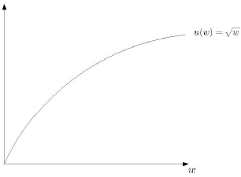
Question 18
Suppose Carl has $70 and the opportunity to invest it in a risky asset that pays him $100 with 25% probability and $60 with 75% probability.
3. Suppose we can represent Carl’s preferences with the utility function 𝑢(𝑤)=√𝑤. Illustrate this utility function in a diagram below
4. Based on the shape of this function we can conclude that Carl is risk averse

Slide 94
Question 18
Suppose Carl has $70 and the opportunity to invest it in a risky asset that pays him $100 with 25% probability and $60 with 75% probability.
5. Carl’s expected utility is 8.309475.
Expected Utility = (0.25)√100+(0.75)√60 = 8.309475

Slide 95
Asymmetric Information

Slide 96
Asymmetric Information
Asymmetric Information : a situation where one party knows more than others
Many markets such as insurance, financial credit and employment are characterized by asymmetric information about product quality
Two types of informational asymmetry: hidden characteristics and hidden actions
Such asymmetric information leads to opportunistic behavior:
Adverse selection or lemons problem.
Moral hazard.

Slide 97
Adverse Selection
Adverse Selection: Used Laptops (also known as the Lemon Problem)
Two kinds of laptops – high quality and low quality (lemons)
Buyers and sellers can distinguish between the laptops (full Information). Everyone is risk neutral.
There are 1000 low quality laptops and 1000 high quality used laptops.
Owners (sellers) of lemons have a reservation price of $300.
Owners of good used laptops have a reservation price of $500.
Demand for both types of laptops is perfectly elastic:
For lemons, consumers are willing to pay $400.
For good used laptops, consumers are willing to pay $800.

Slide 98
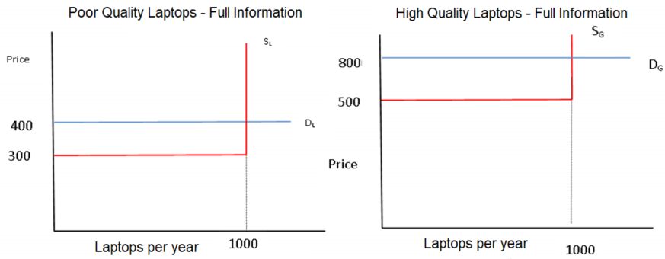
Adverse Selection
Two separate markets. Supply = demand in both
Price = $400 in lemon’s market
Price = $800 for good used laptops
1000 laptops sold in each market. Surplus is maximized and goes to sellers

Slide 99
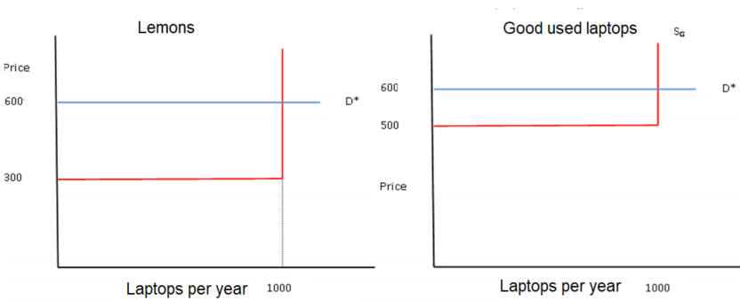
Asymmetric Information with Uninformed Buyers
Buyers don’t know which laptops are good or bad
Therefore, buyers are willing to pay the average value for any laptop, as they cannot distinguish between good and bad.
All laptops sell for $600.
All surplus goes to sellers, but sellers of lemons get more.

Slide 100
Asymmetric Information with Uninformed Buyers
Classic example of adverse selection - low quality items dominate the market in that they are over-represented in transactions
Inefficient → potential surplus is lost
Sellers of good used laptops have no surplus and everyone else is no better off than with full information, so there is a deadweight loss from adverse selection

Slide 101
Question 19
Consider a market for used laptops where sellers know the quality of laptops and buyers do not. There are many potential buyers. Good used laptops are worth $1000 to buyers and lemons are worth only $500 to buyers. Sellers of good laptops will accept $800 (or more) and sellers of lemons will accept $300 or more. There are 100 laptops of each type potentially for sale. Buyers and sellers are risk neutral.
In equilibrium,
The price of lemons will be 500.
100 laptops will be sold.
There is a deadweight loss due to adverse selection of $20,000.
All of the above.
None of the above

Slide 102
Question 19
Consider a market for used laptops where sellers know the quality of laptops and buyers do not. There are many potential buyers. Good used laptops are worth $1000 to buyers and lemons are worth only $500 to buyers. Sellers of good laptops will accept $800 (or more) and sellers of lemons will accept $300 or more. There are 100 laptops of each type potentially for sale. Buyers and sellers are risk neutral.
In equilibrium,
The price of lemons will be 500.
100 laptops will be sold.
There is a deadweight loss due to adverse selection of $20,000.
All of the above.
None of the above
Buyers don’t know if they are buying good laptops or lemons, so the most that they are willing to pay is $750 (expected value of laptop: 0.5*1000+0.5*500)
$750 is less than the reservation price of good laptop sellers (will accept $800 or more)
Therefore, only 100 lemons are sold at $500 each
Customers are willing to pay $1000 for good laptops, buyers are willing to sell at $800
Because good laptops aren’t sold, there is a DWSL of 200*100 = $20,000

Slide 103
Question 20
Consider the following case involving healthy people, unhealthy people, and an insurance company. For healthy people, the expected cost per year is $500. For unhealthy people, $1000 is the expected cost. The insurance company does not have information regarding the health of their customers. The share of healthy people is 0.6. Consumers are risk averse. The risk premium is $100 for each person so a healthy person would pay up to $600 for insurance.
Actuarially fair price: expected payout equals price
If the price of insurance is $700, then healthy people will not buy insurance.
The equilibrium in this case provides insurance only for unhealthy people.
If everyone is insured, the actuarially fair price for the insurance company is $700.
b. and c.
All of the above.

Slide 104
Question 20
Consider the following case involving healthy people, unhealthy people, and an insurance company. For healthy people, the expected cost per year is $500. For unhealthy people, $1000 is the expected cost. The insurance company does not have information regarding the health of their customers. The share of healthy people is 0.6. Consumers are risk averse. The risk premium is $100 for each person so a healthy person would pay up to $600 for insurance.
Actuarially fair price: expected payout equals price
If the price of insurance is $700, then healthy people will not buy insurance.
The equilibrium in this case provides insurance only for unhealthy people.
If everyone is insured, the actuarially fair price for the insurance company is $700.
b. and c.
All of the above.
The actuarially fair price for the insurance company is $500*0.6 + $1000*0.4 = $700
If the price of insurance is $700, then healthy people will not buy insurance. Their expected cost is $500, and max WTP is $100
Remember that the customers are risk averse and have a risk premium of $100 (willing to pay $100 more than expected value for insurance)
Expected value= $500 + $100 = $600 → 700>600
The equilibrium in this case provides insurance only for unhealthy people because healthy people aren’t willing to pay more than $600

Slide 105
Questions

Slide 106
Thanks for Coming!
Best of Luck on your Finals !
🍀🍀🍀

Slide 107


